Slide 1

Business Intelligence technology & Automation Processes to make more accurate decisions for sales operations
B O K H O
Lecturer
Nguyen Van Ho M.S & Le Ba Thien M.S
01
Notes:
Applying Business Intelligence technology and automation processes to make more accurate decisions for sales operations

Slide 2




MEMBERS
B O K H O
Tran Nhat Nguyen
Man Dac Sang
Thai Thien Truc
Nguyen Thai
Ngoc Suong
02
Notes:
01

Slide 3
OUTLINE
B O K H O
01
02
03
04
Introduction
Proposal BI Solution
Business Requirements Analysis
Data source AdventureWorks Database
05
06
07
Building Data warehouse
Data Analytics and Visualization
Conclusion
03
Notes:
01

Slide 4
I. INTRODUCTION
B O K H O
Scope
Helps to analyze data and enhance the decision-making process.
How is the sales performance of the business?
Identify the customer segments of the business.
What is the tendency of customers’ purchasing behaviors?
04
Notes:
Helps to analyze data and enhance the decision-making process.
Identify the customer segments of the business.
How is the sales performance of the business?
What is the tendency of customers’ purchasing behaviors?
Helps to analyze data and enhance the decision-making process.

Slide 5
I. INTRODUCTION
B O K H O
Value &
Desired outcome
Automation in BI saves time, reduces errors, and boosts productivity from data source to end-user.
An effective Business Intelligence solution that includes data collection, storage, processing, analysis, and presentation of results
05
Notes:
Value and desired outcome of the project
An effective Business Intelligence solution that includes data collection, storage, processing, analysis, and presentation of results
Automation in BI saves time, reduces errors, and boosts productivity from data source to end-user.

Slide 6
I. INTRODUCTION
B O K H O
Sales
Business Process
06
Notes:
Value and desired outcome of the project
An effective Business Intelligence solution that includes data collection, storage, processing, analysis, and presentation of results
Automation in BI saves time, reduces errors, and boosts productivity from data source to end-user.

Slide 7
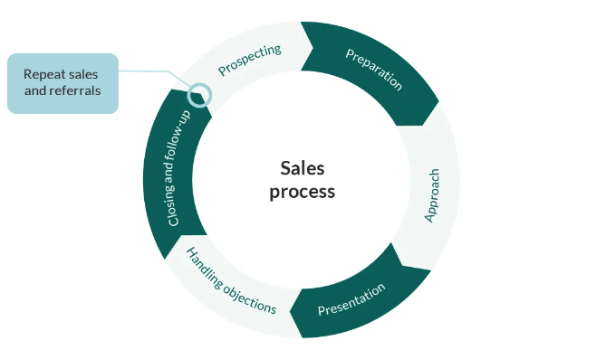
I. INTRODUCTION
B O K H O
Sales
Business Process
Cre: SuperOffice. (2023, February 21). Sales Process: A Structured Approach to Closing Sales Faster!
https://www.superoffice.com/blog/sales-process/
07
Notes:
Value and desired outcome of the project
An effective Business Intelligence solution that includes data collection, storage, processing, analysis, and presentation of results
Automation in BI saves time, reduces errors, and boosts productivity from data source to end-user.

Slide 8

II. BUSINESS REQUIREMENTS ANALYSIS
B O K H O
How is the sales performance of the business?
Identify the customer segments of the business?
What is the tendency of customers’ purchasing behaviors?
08
Notes:
How is the sales performance of the business
Discover sales performance by regions.
acknowledge the regions that are performing well or not
providing useful insights into customer behaviors and preferences in different places
Adapt their marketing and sales strategies to better
Acknowledge sales performance across online and offline channels.
identify which channels generate the most revenue, which channels are performing poorly
Identify most effective channels for promoting specific product items.
Evaluate sales performance by analyzing delivery performance in different regions.
Is one of the determining factors of customer satisfaction
The decision-maker can easily track status, optimize transportation costs, and make decisions that improve customer satisfaction, such as on-time delivery rate, the number of completed deliveries, the average time per delivery, and the highest/lowest performing carrier.

Slide 9



II. BUSINESS REQUIREMENTS ANALYSIS
B O K H O
1. Discover sales performance by regions
Acknowledge the regions that are performing well or not.
Adapt their marketing and sales strategies better.
How is the sales performance of the business?
Providing useful insights into customer behaviors and preferences in different places.
09
Notes:
How is the sales performance of the business
Discover sales performance by regions.
acknowledge the regions that are performing well or not
providing useful insights into customer behaviors and preferences in different places
Adapt their marketing and sales strategies to better
Acknowledge sales performance across online and offline channels.
identify which channels generate the most revenue, which channels are performing poorly
Identify most effective channels for promoting specific product items.
Evaluate sales performance by analyzing delivery performance in different regions.
Is one of the determining factors of customer satisfaction
The decision-maker can easily track status, optimize transportation costs, and make decisions that improve customer satisfaction, such as on-time delivery rate, the number of completed deliveries, the average time per delivery, and the highest/lowest performing carrier.

Slide 10


II. BUSINESS REQUIREMENTS ANALYSIS
B O K H O
2. Acknowledge sales performance across online and offline channels
Identify which channels generate the most revenue, which channels are performing poorly.
How is the sales performance of the business?
Identify most effective channels for promoting specific product items.
10
Notes:
How is the sales performance of the business
Discover sales performance by regions.
acknowledge the regions that are performing well or not
providing useful insights into customer behaviors and preferences in different places
Adapt their marketing and sales strategies to better
Acknowledge sales performance across online and offline channels.
identify which channels generate the most revenue, which channels are performing poorly
Identify most effective channels for promoting specific product items.
Evaluate sales performance by analyzing delivery performance in different regions.
Is one of the determining factors of customer satisfaction
The decision-maker can easily track status, optimize transportation costs, and make decisions that improve customer satisfaction, such as on-time delivery rate, the number of completed deliveries, the average time per delivery, and the highest/lowest performing carrier.

Slide 11
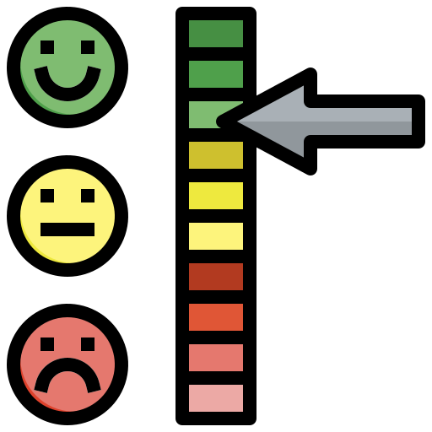

II. BUSINESS REQUIREMENTS ANALYSIS
B O K H O
3. Evaluate sales performance by analyzing delivery performance in different regions
Is one of the determining factors of customer satisfaction.
How is the sales performance of the business?
The decision-maker can easily track status, optimize transportation costs, and make decisions that improve customer satisfaction.
11
Notes:
How is the sales performance of the business
Discover sales performance by regions.
acknowledge the regions that are performing well or not
providing useful insights into customer behaviors and preferences in different places
Adapt their marketing and sales strategies to better
Acknowledge sales performance across online and offline channels.
identify which channels generate the most revenue, which channels are performing poorly
Identify most effective channels for promoting specific product items.
Evaluate sales performance by analyzing delivery performance in different regions.
Is one of the determining factors of customer satisfaction
The decision-maker can easily track status, optimize transportation costs, and make decisions that improve customer satisfaction, such as on-time delivery rate, the number of completed deliveries, the average time per delivery, and the highest/lowest performing carrier.

Slide 12
II. BUSINESS REQUIREMENTS ANALYSIS
B O K H O
1. Identify customer segments using RFM model
Identify the customer segments of the business?
12
Notes:
How is the sales performance of the business
Discover sales performance by regions.
acknowledge the regions that are performing well or not
providing useful insights into customer behaviors and preferences in different places
Adapt their marketing and sales strategies to better
Acknowledge sales performance across online and offline channels.
identify which channels generate the most revenue, which channels are performing poorly
Identify most effective channels for promoting specific product items.
Evaluate sales performance by analyzing delivery performance in different regions.
Is one of the determining factors of customer satisfaction
The decision-maker can easily track status, optimize transportation costs, and make decisions that improve customer satisfaction, such as on-time delivery rate, the number of completed deliveries, the average time per delivery, and the highest/lowest performing carrier.

Slide 13
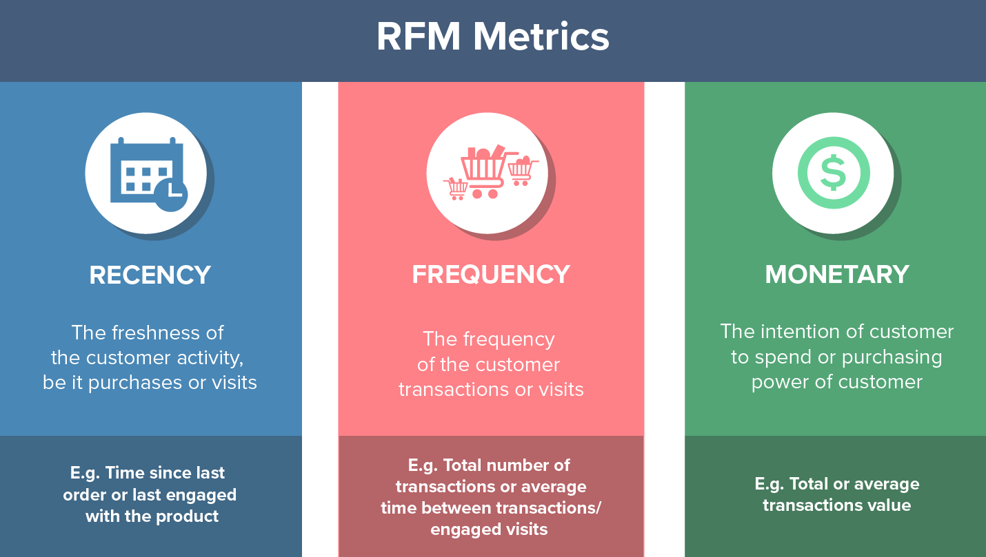

II. BUSINESS REQUIREMENTS ANALYSIS
B O K H O
1. Identify customer segments using RFM model.
Identify the customer segments of the business
Cre: Digalyst. (2022, March 5). Mô hình RFM - Phân tích RFM: Làm Marketing phải biết! - Digalyst. Digalyst. https://digalyst.com/digital-marketing/mo-hinh-rfm-phan-tich-rfm-lam-marketing-phai-biet/
Customize their marketing efforts for each group.
Creation of more personalized experiences for individual customers, which can result in increased customer loyalty and satisfaction.
13
Notes:
How is the sales performance of the business
Discover sales performance by regions.
acknowledge the regions that are performing well or not
providing useful insights into customer behaviors and preferences in different places
Adapt their marketing and sales strategies to better
Acknowledge sales performance across online and offline channels.
identify which channels generate the most revenue, which channels are performing poorly
Identify most effective channels for promoting specific product items.
Evaluate sales performance by analyzing delivery performance in different regions.
Is one of the determining factors of customer satisfaction
The decision-maker can easily track status, optimize transportation costs, and make decisions that improve customer satisfaction, such as on-time delivery rate, the number of completed deliveries, the average time per delivery, and the highest/lowest performing carrier.

Slide 14

II. BUSINESS REQUIREMENTS ANALYSIS
B O K H O
1. Analyze customer trends in purchasing behavior for specific products using cross-selling
Analyze customer trends in purchasing behavior for specific products using cross-selling.
What is the tendency of customers’ purchasing behaviors?
14
Notes:
How is the sales performance of the business
Discover sales performance by regions.
acknowledge the regions that are performing well or not
providing useful insights into customer behaviors and preferences in different places
Adapt their marketing and sales strategies to better
Acknowledge sales performance across online and offline channels.
identify which channels generate the most revenue, which channels are performing poorly
Identify most effective channels for promoting specific product items.
Evaluate sales performance by analyzing delivery performance in different regions.
Is one of the determining factors of customer satisfaction
The decision-maker can easily track status, optimize transportation costs, and make decisions that improve customer satisfaction, such as on-time delivery rate, the number of completed deliveries, the average time per delivery, and the highest/lowest performing carrier.

Slide 15
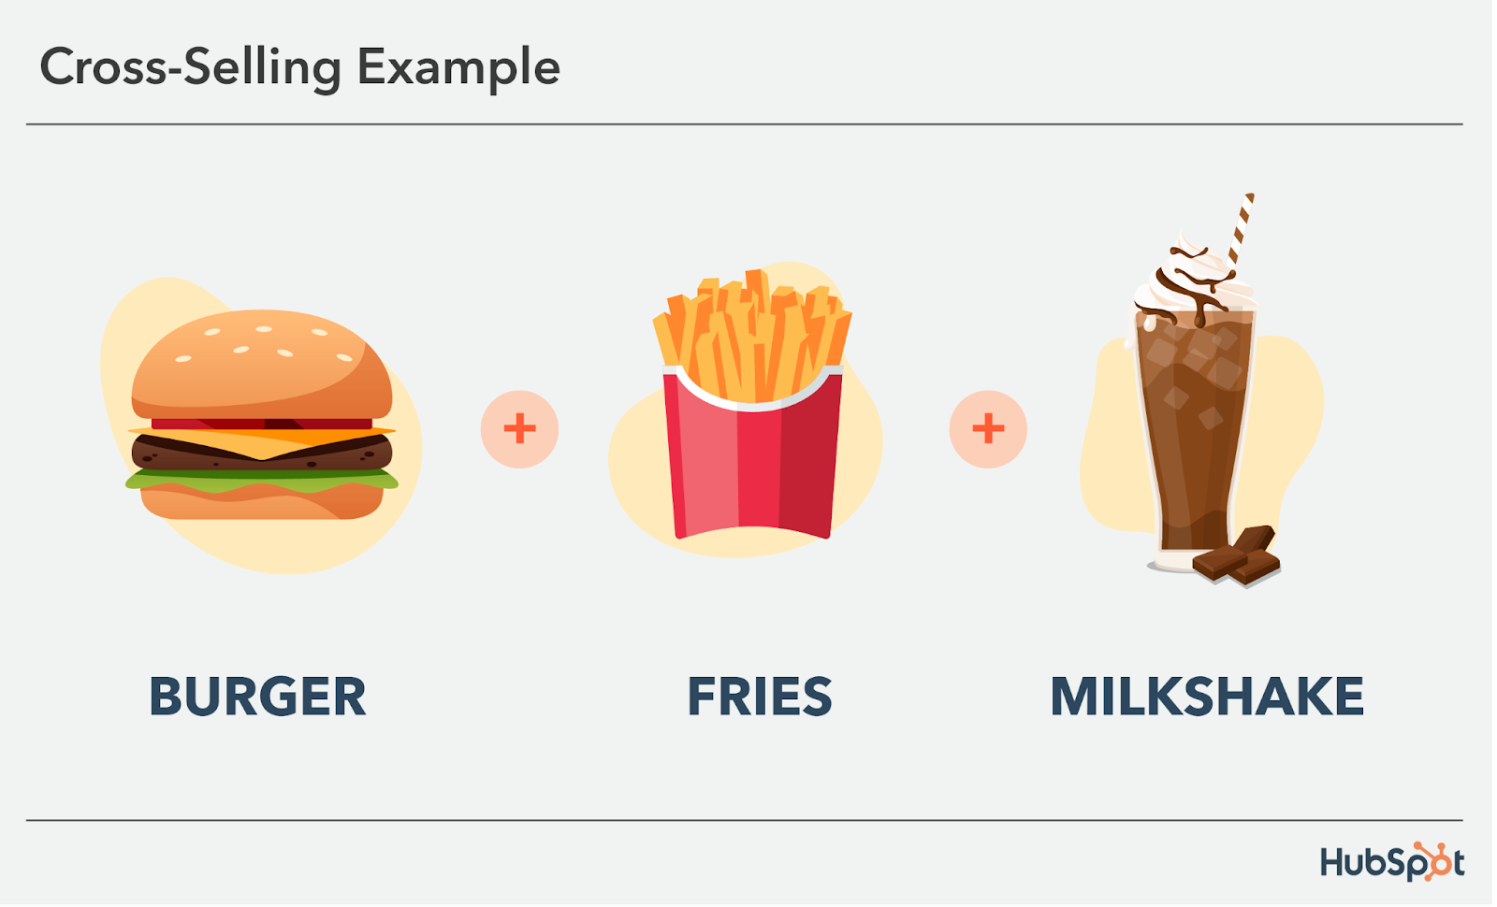
II. BUSINESS REQUIREMENTS ANALYSIS
B O K H O
2. Analyze customer trends in purchasing behavior for specific products using cross-selling
What is the tendency of customers’ purchasing behaviors?
Cross-selling data helps businesses identify the products that customers tend to purchase together, which can provide valuable insight into what customers are looking for.
14
15
Notes:
How is the sales performance of the business
Discover sales performance by regions.
acknowledge the regions that are performing well or not
providing useful insights into customer behaviors and preferences in different places
Adapt their marketing and sales strategies to better
Acknowledge sales performance across online and offline channels.
identify which channels generate the most revenue, which channels are performing poorly
Identify most effective channels for promoting specific product items.
Evaluate sales performance by analyzing delivery performance in different regions.
Is one of the determining factors of customer satisfaction
The decision-maker can easily track status, optimize transportation costs, and make decisions that improve customer satisfaction, such as on-time delivery rate, the number of completed deliveries, the average time per delivery, and the highest/lowest performing carrier.

Slide 16
II. BUSINESS REQUIREMENTS ANALYSIS
B O K H O
2. Categorize products items based on their importance by ABC classification.
What is the tendency of customers’ purchasing behaviors?
16
Notes:
How is the sales performance of the business
Discover sales performance by regions.
acknowledge the regions that are performing well or not
providing useful insights into customer behaviors and preferences in different places
Adapt their marketing and sales strategies to better
Acknowledge sales performance across online and offline channels.
identify which channels generate the most revenue, which channels are performing poorly
Identify most effective channels for promoting specific product items.
Evaluate sales performance by analyzing delivery performance in different regions.
Is one of the determining factors of customer satisfaction
The decision-maker can easily track status, optimize transportation costs, and make decisions that improve customer satisfaction, such as on-time delivery rate, the number of completed deliveries, the average time per delivery, and the highest/lowest performing carrier.

Slide 17
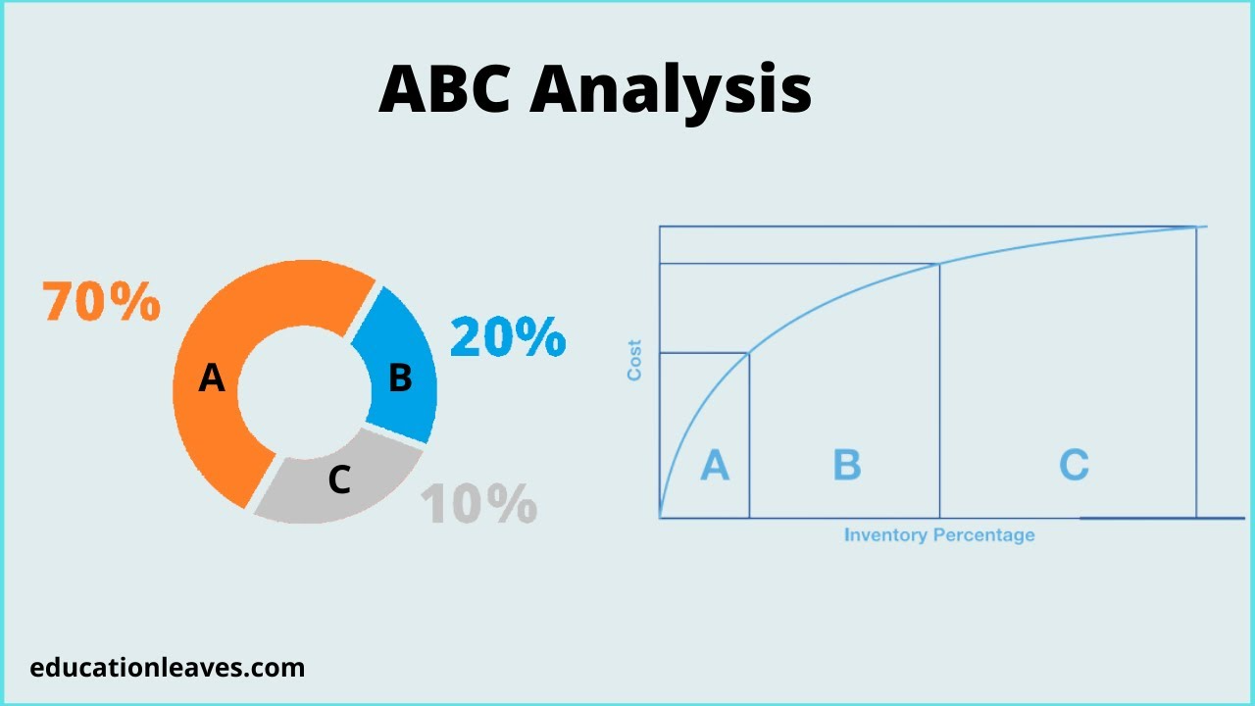

II. BUSINESS REQUIREMENTS ANALYSIS
B O K H O
2. What is the tendency of customers’ purchasing behaviors
Analyze customer trends in purchasing behavior for specific products using cross-selling.
Identify the customer segments of the business
Categorize products items based on their importance by ABC classification.
Gain insights into customer demand and behavior
Reduce the cost, optimize their supply chain and minimize inventory management costs.
17
Notes:
How is the sales performance of the business
Discover sales performance by regions.
acknowledge the regions that are performing well or not
providing useful insights into customer behaviors and preferences in different places
Adapt their marketing and sales strategies to better
Acknowledge sales performance across online and offline channels.
identify which channels generate the most revenue, which channels are performing poorly
Identify most effective channels for promoting specific product items.
Evaluate sales performance by analyzing delivery performance in different regions.
Is one of the determining factors of customer satisfaction
The decision-maker can easily track status, optimize transportation costs, and make decisions that improve customer satisfaction, such as on-time delivery rate, the number of completed deliveries, the average time per delivery, and the highest/lowest performing carrier.

Slide 18
III. DATA SOURCE ADVENTUREWORKS DATABASE
B O K H O
18
Notes:
How is the sales performance of the business
Discover sales performance by regions.
acknowledge the regions that are performing well or not
providing useful insights into customer behaviors and preferences in different places
Adapt their marketing and sales strategies to better
Acknowledge sales performance across online and offline channels.
identify which channels generate the most revenue, which channels are performing poorly
Identify most effective channels for promoting specific product items.
Evaluate sales performance by analyzing delivery performance in different regions.
Is one of the determining factors of customer satisfaction
The decision-maker can easily track status, optimize transportation costs, and make decisions that improve customer satisfaction, such as on-time delivery rate, the number of completed deliveries, the average time per delivery, and the highest/lowest performing carrier.

Slide 19
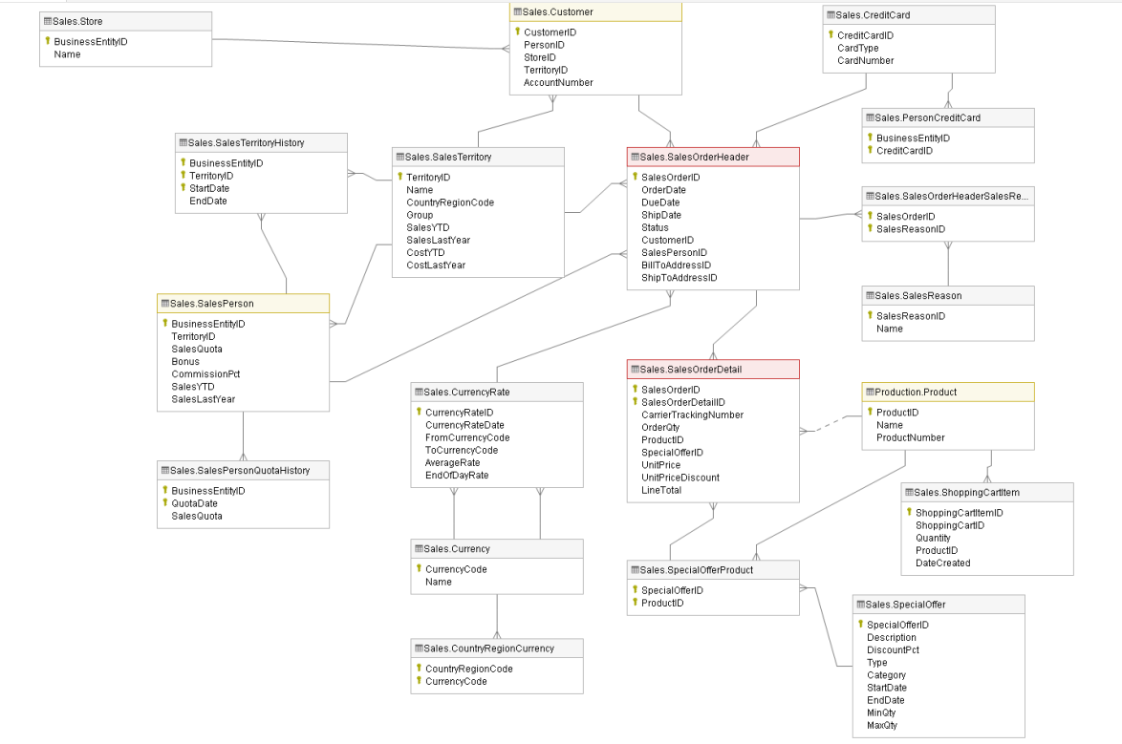
III. DATA SOURCE ADVENTUREWORKS DATABASE
SCHEMA SALES
B O K H O
19
Cre: https://learn.microsoft.com/en-us/sql/samples/adventureworks-install-configure?view=sql-server-ver16&tabs=ssms
Notes:
How is the sales performance of the business
Discover sales performance by regions.
acknowledge the regions that are performing well or not
providing useful insights into customer behaviors and preferences in different places
Adapt their marketing and sales strategies to better
Acknowledge sales performance across online and offline channels.
identify which channels generate the most revenue, which channels are performing poorly
Identify most effective channels for promoting specific product items.
Evaluate sales performance by analyzing delivery performance in different regions.
Is one of the determining factors of customer satisfaction
The decision-maker can easily track status, optimize transportation costs, and make decisions that improve customer satisfaction, such as on-time delivery rate, the number of completed deliveries, the average time per delivery, and the highest/lowest performing carrier.

Slide 20
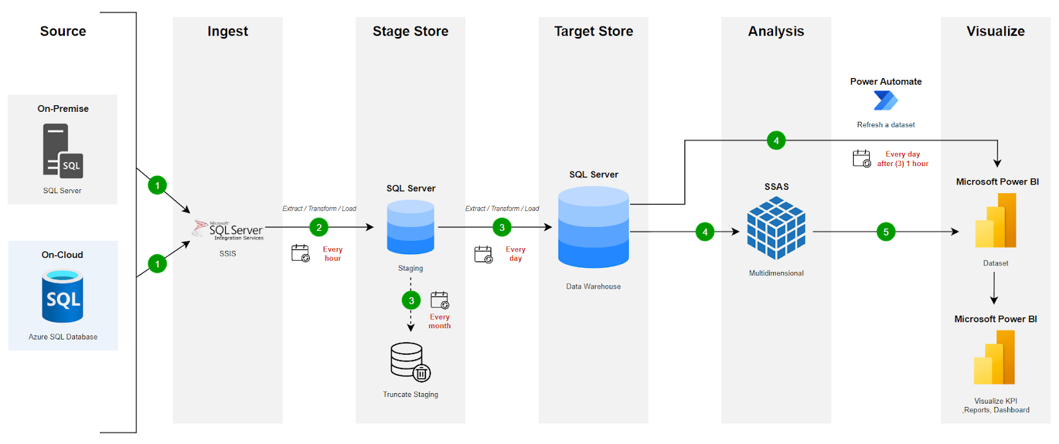
IV. PROPOSAL BI SOLUTION
B O K H O
20
BI Solution (Source: Author's proposal)
Notes:
How is the sales performance of the business
Discover sales performance by regions.
acknowledge the regions that are performing well or not
providing useful insights into customer behaviors and preferences in different places
Adapt their marketing and sales strategies to better
Acknowledge sales performance across online and offline channels.
identify which channels generate the most revenue, which channels are performing poorly
Identify most effective channels for promoting specific product items.
Evaluate sales performance by analyzing delivery performance in different regions.
Is one of the determining factors of customer satisfaction
The decision-maker can easily track status, optimize transportation costs, and make decisions that improve customer satisfaction, such as on-time delivery rate, the number of completed deliveries, the average time per delivery, and the highest/lowest performing carrier.

Slide 21
V. BUILDING DATA WAREHOUSE
B O K H O
21
Notes:
How is the sales performance of the business
Discover sales performance by regions.
acknowledge the regions that are performing well or not
providing useful insights into customer behaviors and preferences in different places
Adapt their marketing and sales strategies to better
Acknowledge sales performance across online and offline channels.
identify which channels generate the most revenue, which channels are performing poorly
Identify most effective channels for promoting specific product items.
Evaluate sales performance by analyzing delivery performance in different regions.
Is one of the determining factors of customer satisfaction
The decision-maker can easily track status, optimize transportation costs, and make decisions that improve customer satisfaction, such as on-time delivery rate, the number of completed deliveries, the average time per delivery, and the highest/lowest performing carrier.

Slide 22
V. BUILDING DATA WAREHOUSE
1. BUS MATRIX
B O K H O
 | Employee | Product | Customer | Store | Channel | Geography | ShipMethod | Date
Customer segmentation |  |  | x |  |  |  |  | x
Delivery performance tracking |  |  |  |  | x | x | x | x
Sales performance by channel | x |  | x | x | x |  |  | x
Sales performance by region |  |  |  |  |  | x |  | x
Purchasing behavior |  | x | x |  | x | x |  | x
ABC Classification |  | x | x |  | x | x |  | x
22
Notes:
How is the sales performance of the business
Discover sales performance by regions.
acknowledge the regions that are performing well or not
providing useful insights into customer behaviors and preferences in different places
Adapt their marketing and sales strategies to better
Acknowledge sales performance across online and offline channels.
identify which channels generate the most revenue, which channels are performing poorly
Identify most effective channels for promoting specific product items.
Evaluate sales performance by analyzing delivery performance in different regions.
Is one of the determining factors of customer satisfaction
The decision-maker can easily track status, optimize transportation costs, and make decisions that improve customer satisfaction, such as on-time delivery rate, the number of completed deliveries, the average time per delivery, and the highest/lowest performing carrier.

Slide 23
V. BUILDING DATA WAREHOUSE
B O K H O
2. MASTER DATA
3. TRANSACTION DATA
Object | Description
Customer | Information about Customers (Name,YearlyIncome, Gender..)
Employee | Information about Employee(Name, Birth Date, Gender..)
Product | Information about Products (SubCategory, Category, Name..)
Store | Information about Stores (Name, Year Opened..)
Geography | Information about Postal Code, Region..
Ship Method | Information about Ship Methods
Object | Description
Order Header Transaction Data | Information about SubTotal, TaxAmt, Freight, TotalDue..
Order Detail Transaction Data | Information about ProductID, Order Quantity, Unit Price.
23
Notes:
How is the sales performance of the business
Discover sales performance by regions.
acknowledge the regions that are performing well or not
providing useful insights into customer behaviors and preferences in different places
Adapt their marketing and sales strategies to better
Acknowledge sales performance across online and offline channels.
identify which channels generate the most revenue, which channels are performing poorly
Identify most effective channels for promoting specific product items.
Evaluate sales performance by analyzing delivery performance in different regions.
Is one of the determining factors of customer satisfaction
The decision-maker can easily track status, optimize transportation costs, and make decisions that improve customer satisfaction, such as on-time delivery rate, the number of completed deliveries, the average time per delivery, and the highest/lowest performing carrier.

Slide 24
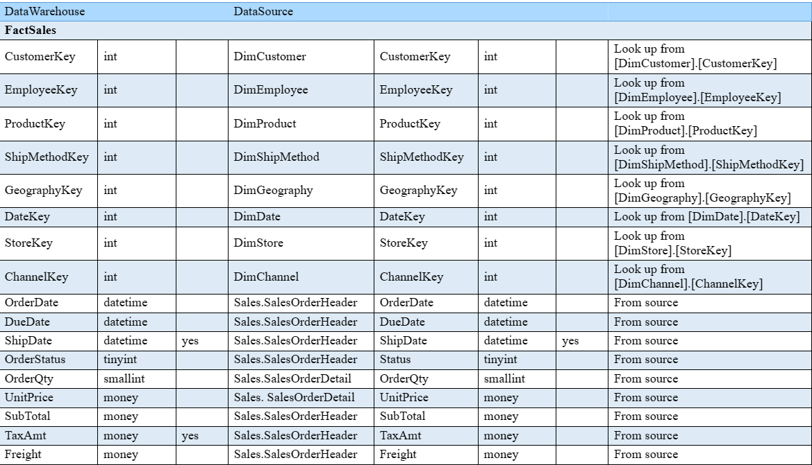
V. BUILDING DATA WAREHOUSE
4. ETL MAPPING
B O K H O
24
Notes:
How is the sales performance of the business
Discover sales performance by regions.
acknowledge the regions that are performing well or not
providing useful insights into customer behaviors and preferences in different places
Adapt their marketing and sales strategies to better
Acknowledge sales performance across online and offline channels.
identify which channels generate the most revenue, which channels are performing poorly
Identify most effective channels for promoting specific product items.
Evaluate sales performance by analyzing delivery performance in different regions.
Is one of the determining factors of customer satisfaction
The decision-maker can easily track status, optimize transportation costs, and make decisions that improve customer satisfaction, such as on-time delivery rate, the number of completed deliveries, the average time per delivery, and the highest/lowest performing carrier.

Slide 25
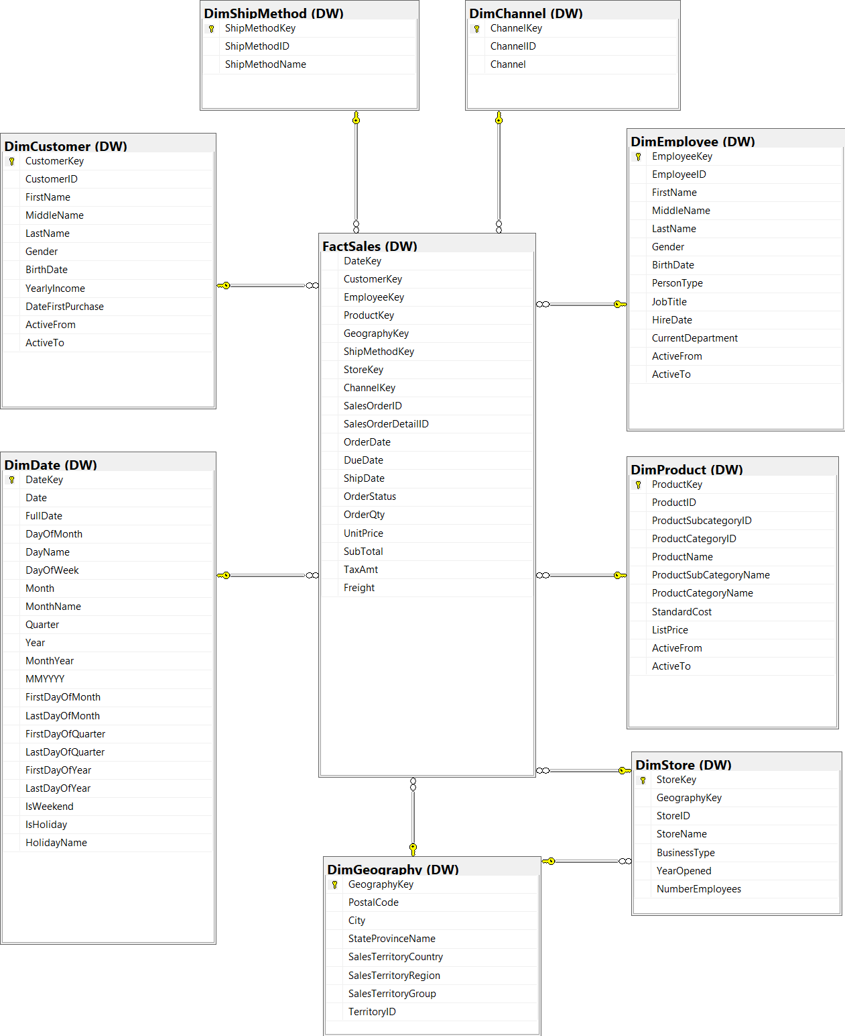
V. BUILDING DATA WAREHOUSE
5. DATA WAREHOUSE MODEL
B O K H O
Data Warehouse Star Schema
25
Notes:
How is the sales performance of the business
Discover sales performance by regions.
acknowledge the regions that are performing well or not
providing useful insights into customer behaviors and preferences in different places
Adapt their marketing and sales strategies to better
Acknowledge sales performance across online and offline channels.
identify which channels generate the most revenue, which channels are performing poorly
Identify most effective channels for promoting specific product items.
Evaluate sales performance by analyzing delivery performance in different regions.
Is one of the determining factors of customer satisfaction
The decision-maker can easily track status, optimize transportation costs, and make decisions that improve customer satisfaction, such as on-time delivery rate, the number of completed deliveries, the average time per delivery, and the highest/lowest performing carrier.

Slide 26
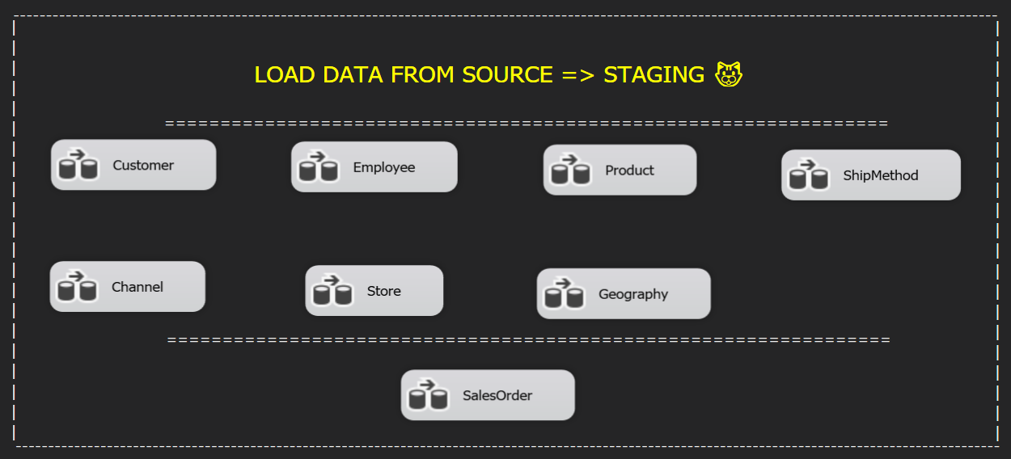
V. BUILDING DATA WAREHOUSE
6. ETL PROCESSES
B O K H O
6.1 Load Source to Staging
To break down the amount of data being loaded from the source into staging, we have set up an automated system to run every hour.
26
Notes:
How is the sales performance of the business
Discover sales performance by regions.
acknowledge the regions that are performing well or not
providing useful insights into customer behaviors and preferences in different places
Adapt their marketing and sales strategies to better
Acknowledge sales performance across online and offline channels.
identify which channels generate the most revenue, which channels are performing poorly
Identify most effective channels for promoting specific product items.
Evaluate sales performance by analyzing delivery performance in different regions.
Is one of the determining factors of customer satisfaction
The decision-maker can easily track status, optimize transportation costs, and make decisions that improve customer satisfaction, such as on-time delivery rate, the number of completed deliveries, the average time per delivery, and the highest/lowest performing carrier.

Slide 27
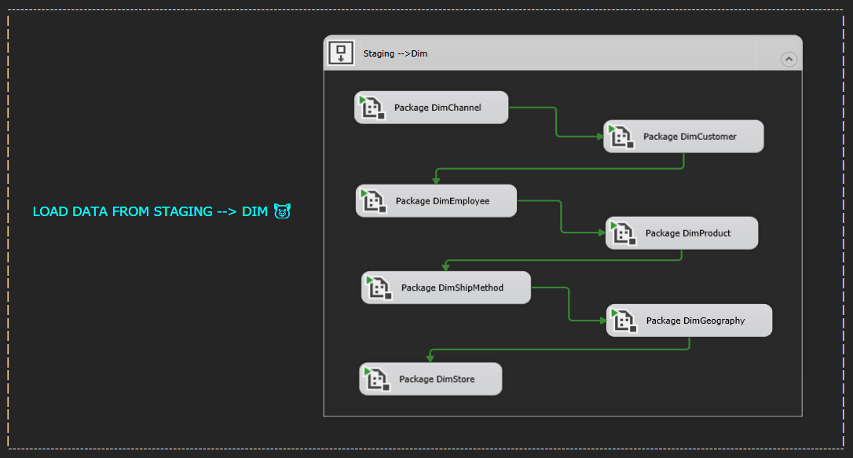
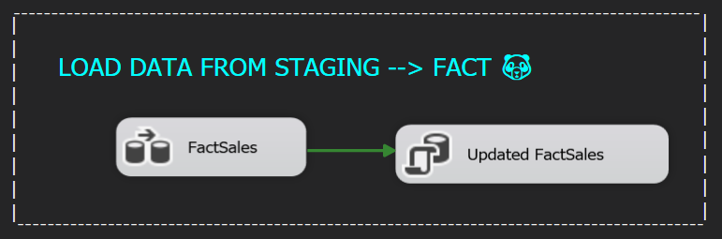
V. BUILDING DATA WAREHOUSE
6. ETL PROCESSES
B O K H O
6.2 Load Staging to Data warehouse
To enable observers to track the fluctuation of the business, data used for reporting in the data warehouse will be updated on a daily basis.
27
Notes:
How is the sales performance of the business
Discover sales performance by regions.
acknowledge the regions that are performing well or not
providing useful insights into customer behaviors and preferences in different places
Adapt their marketing and sales strategies to better
Acknowledge sales performance across online and offline channels.
identify which channels generate the most revenue, which channels are performing poorly
Identify most effective channels for promoting specific product items.
Evaluate sales performance by analyzing delivery performance in different regions.
Is one of the determining factors of customer satisfaction
The decision-maker can easily track status, optimize transportation costs, and make decisions that improve customer satisfaction, such as on-time delivery rate, the number of completed deliveries, the average time per delivery, and the highest/lowest performing carrier.

Slide 28
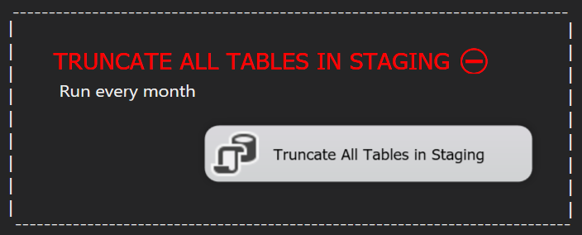
V. BUILDING DATA WAREHOUSE
6. ETL PROCESSES
B O K H O
6.3 Truncate Staging
To save storage space, data in staging will be deleted every month upon confirmation that there are no issues in the data warehouse.
28
Notes:
How is the sales performance of the business
Discover sales performance by regions.
acknowledge the regions that are performing well or not
providing useful insights into customer behaviors and preferences in different places
Adapt their marketing and sales strategies to better
Acknowledge sales performance across online and offline channels.
identify which channels generate the most revenue, which channels are performing poorly
Identify most effective channels for promoting specific product items.
Evaluate sales performance by analyzing delivery performance in different regions.
Is one of the determining factors of customer satisfaction
The decision-maker can easily track status, optimize transportation costs, and make decisions that improve customer satisfaction, such as on-time delivery rate, the number of completed deliveries, the average time per delivery, and the highest/lowest performing carrier.

Slide 29
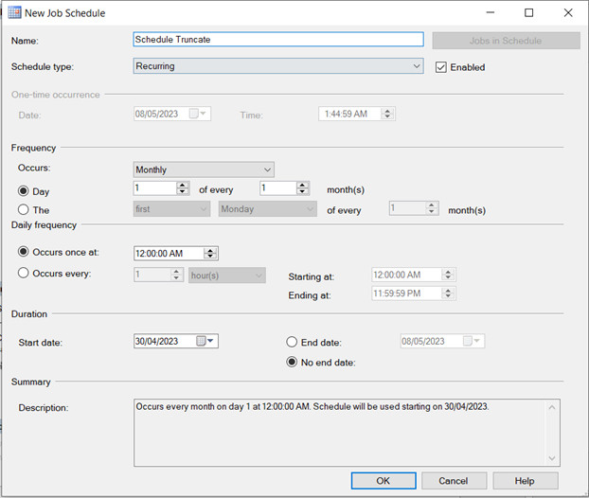
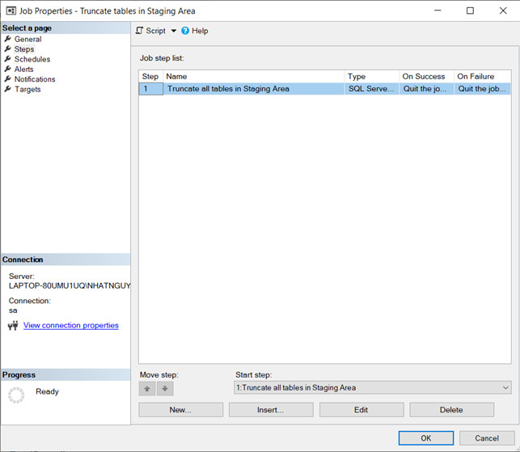
V. BUILDING DATA WAREHOUSE
B O K H O
6. ETL PROCESSES
6.4 Schedule job (local implement)
Configure the ETL steps
Determine the suitable time for this iteration based on our business needs
29
Notes:
How is the sales performance of the business
Discover sales performance by regions.
acknowledge the regions that are performing well or not
providing useful insights into customer behaviors and preferences in different places
Adapt their marketing and sales strategies to better
Acknowledge sales performance across online and offline channels.
identify which channels generate the most revenue, which channels are performing poorly
Identify most effective channels for promoting specific product items.
Evaluate sales performance by analyzing delivery performance in different regions.
Is one of the determining factors of customer satisfaction
The decision-maker can easily track status, optimize transportation costs, and make decisions that improve customer satisfaction, such as on-time delivery rate, the number of completed deliveries, the average time per delivery, and the highest/lowest performing carrier.

Slide 30
VI. DATA ANALYTICS AND VISUALIZATION
B O K H O
30
Notes:
How is the sales performance of the business
Discover sales performance by regions.
acknowledge the regions that are performing well or not
providing useful insights into customer behaviors and preferences in different places
Adapt their marketing and sales strategies to better
Acknowledge sales performance across online and offline channels.
identify which channels generate the most revenue, which channels are performing poorly
Identify most effective channels for promoting specific product items.
Evaluate sales performance by analyzing delivery performance in different regions.
Is one of the determining factors of customer satisfaction
The decision-maker can easily track status, optimize transportation costs, and make decisions that improve customer satisfaction, such as on-time delivery rate, the number of completed deliveries, the average time per delivery, and the highest/lowest performing carrier.

Slide 31
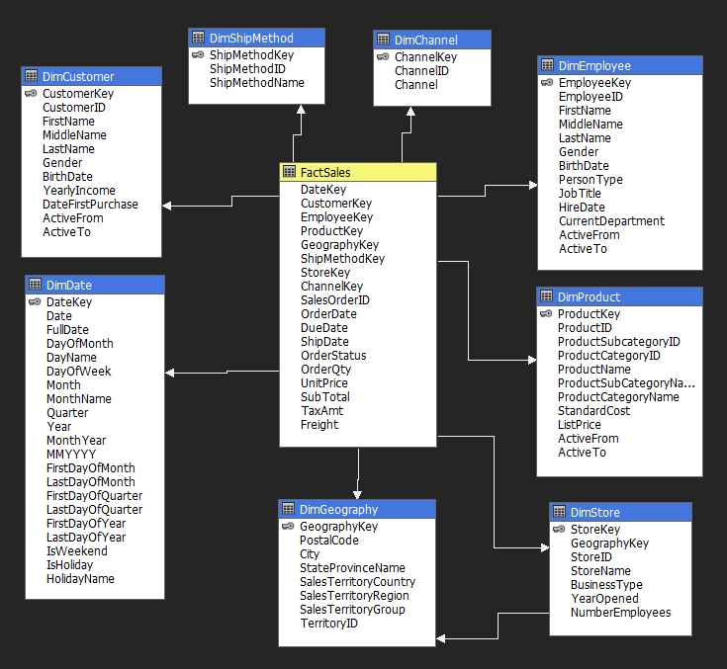
VI. DATA ANALYTICS AND VISUALIZATION
1. SASS TECHNOLOGY
B O K H O
31
Notes:
How is the sales performance of the business
Discover sales performance by regions.
acknowledge the regions that are performing well or not
providing useful insights into customer behaviors and preferences in different places
Adapt their marketing and sales strategies to better
Acknowledge sales performance across online and offline channels.
identify which channels generate the most revenue, which channels are performing poorly
Identify most effective channels for promoting specific product items.
Evaluate sales performance by analyzing delivery performance in different regions.
Is one of the determining factors of customer satisfaction
The decision-maker can easily track status, optimize transportation costs, and make decisions that improve customer satisfaction, such as on-time delivery rate, the number of completed deliveries, the average time per delivery, and the highest/lowest performing carrier.

Slide 32
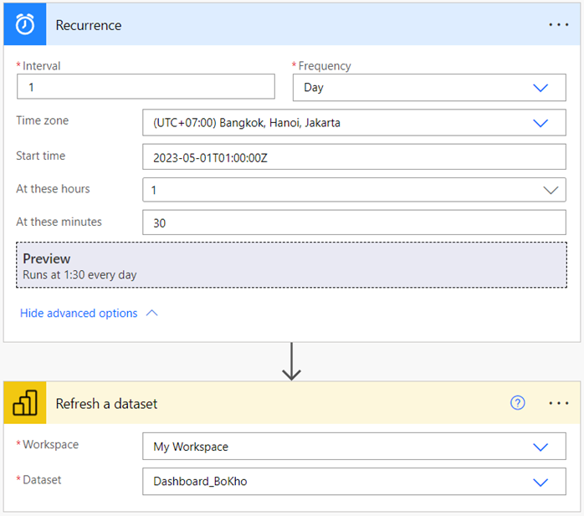

VI. DATA ANALYTICS AND VISUALIZATION
2. INCREMENTAL REFRESH USING POWER AUTOMATE
B O K H O
Power Automate
32
Notes:
How is the sales performance of the business
Discover sales performance by regions.
acknowledge the regions that are performing well or not
providing useful insights into customer behaviors and preferences in different places
Adapt their marketing and sales strategies to better
Acknowledge sales performance across online and offline channels.
identify which channels generate the most revenue, which channels are performing poorly
Identify most effective channels for promoting specific product items.
Evaluate sales performance by analyzing delivery performance in different regions.
Is one of the determining factors of customer satisfaction
The decision-maker can easily track status, optimize transportation costs, and make decisions that improve customer satisfaction, such as on-time delivery rate, the number of completed deliveries, the average time per delivery, and the highest/lowest performing carrier.

Slide 33
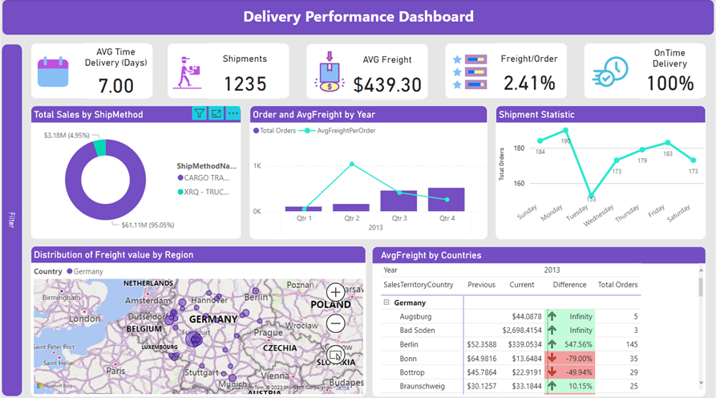
VI. DATA ANALYTICS AND VISUALIZATION
3. POWER BI
B O K H O
33
3.1 Delivery Performance
Notes:
How is the sales performance of the business
Discover sales performance by regions.
acknowledge the regions that are performing well or not
providing useful insights into customer behaviors and preferences in different places
Adapt their marketing and sales strategies to better
Acknowledge sales performance across online and offline channels.
identify which channels generate the most revenue, which channels are performing poorly
Identify most effective channels for promoting specific product items.
Evaluate sales performance by analyzing delivery performance in different regions.
Is one of the determining factors of customer satisfaction
The decision-maker can easily track status, optimize transportation costs, and make decisions that improve customer satisfaction, such as on-time delivery rate, the number of completed deliveries, the average time per delivery, and the highest/lowest performing carrier.

Slide 34
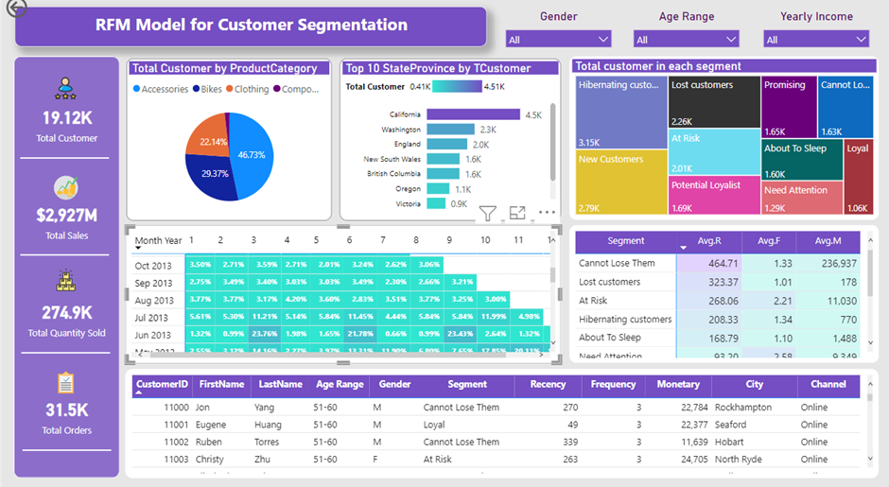
VI. DATA ANALYTICS AND VISUALIZATION
3. POWER BI
B O K H O
34
3.2 RFM
Notes:
How is the sales performance of the business
Discover sales performance by regions.
acknowledge the regions that are performing well or not
providing useful insights into customer behaviors and preferences in different places
Adapt their marketing and sales strategies to better
Acknowledge sales performance across online and offline channels.
identify which channels generate the most revenue, which channels are performing poorly
Identify most effective channels for promoting specific product items.
Evaluate sales performance by analyzing delivery performance in different regions.
Is one of the determining factors of customer satisfaction
The decision-maker can easily track status, optimize transportation costs, and make decisions that improve customer satisfaction, such as on-time delivery rate, the number of completed deliveries, the average time per delivery, and the highest/lowest performing carrier.

Slide 35
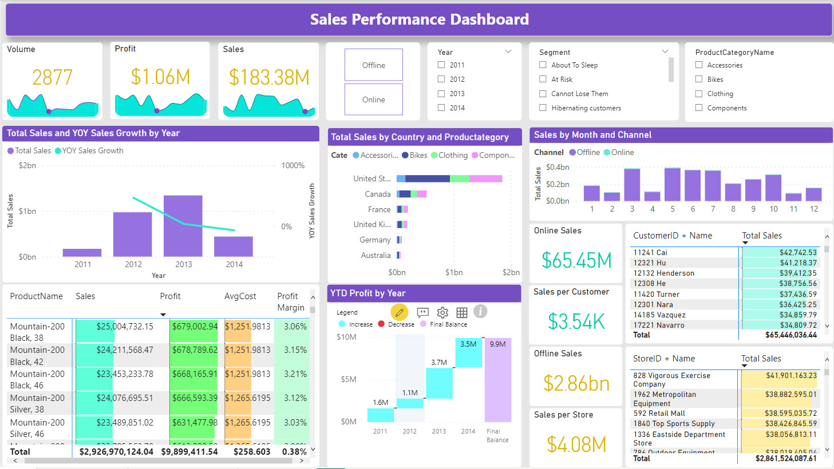
VI. DATA ANALYTICS AND VISUALIZATION
3. POWER BI
B O K H O
35
3.3 Sales Performance
Notes:
How is the sales performance of the business
Discover sales performance by regions.
acknowledge the regions that are performing well or not
providing useful insights into customer behaviors and preferences in different places
Adapt their marketing and sales strategies to better
Acknowledge sales performance across online and offline channels.
identify which channels generate the most revenue, which channels are performing poorly
Identify most effective channels for promoting specific product items.
Evaluate sales performance by analyzing delivery performance in different regions.
Is one of the determining factors of customer satisfaction
The decision-maker can easily track status, optimize transportation costs, and make decisions that improve customer satisfaction, such as on-time delivery rate, the number of completed deliveries, the average time per delivery, and the highest/lowest performing carrier.

Slide 36
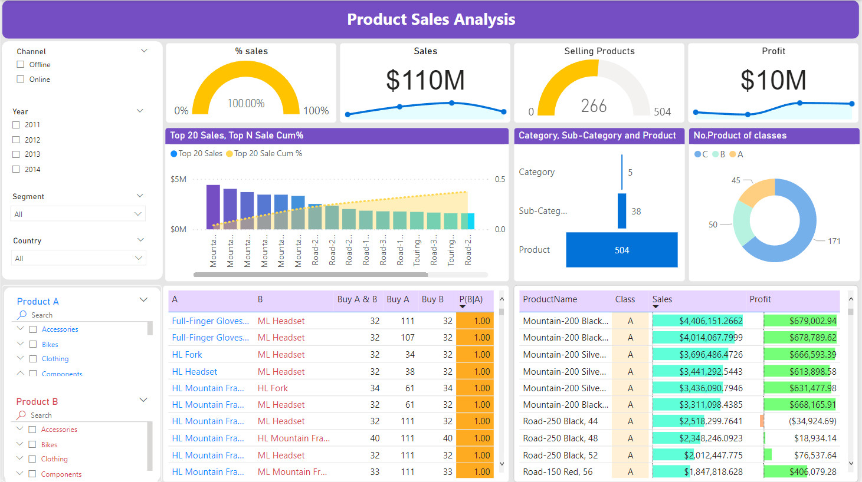
VI. DATA ANALYTICS AND VISUALIZATION
3. POWER BI
B O K H O
36
3.4 Product Sales Analysis
Notes:
How is the sales performance of the business
Discover sales performance by regions.
acknowledge the regions that are performing well or not
providing useful insights into customer behaviors and preferences in different places
Adapt their marketing and sales strategies to better
Acknowledge sales performance across online and offline channels.
identify which channels generate the most revenue, which channels are performing poorly
Identify most effective channels for promoting specific product items.
Evaluate sales performance by analyzing delivery performance in different regions.
Is one of the determining factors of customer satisfaction
The decision-maker can easily track status, optimize transportation costs, and make decisions that improve customer satisfaction, such as on-time delivery rate, the number of completed deliveries, the average time per delivery, and the highest/lowest performing carrier.

Slide 37




VI. DATA ANALYTICS AND VISUALIZATION
B O K H O
What can we solve requirements with dashboards ?
Marketing strategies for 3 main segments.
Optimize delivery performance.
Enhance sales performance.
Product-based strategy.
37
Notes:
How is the sales performance of the business
Discover sales performance by regions.
acknowledge the regions that are performing well or not
providing useful insights into customer behaviors and preferences in different places
Adapt their marketing and sales strategies to better
Acknowledge sales performance across online and offline channels.
identify which channels generate the most revenue, which channels are performing poorly
Identify most effective channels for promoting specific product items.
Evaluate sales performance by analyzing delivery performance in different regions.
Is one of the determining factors of customer satisfaction
The decision-maker can easily track status, optimize transportation costs, and make decisions that improve customer satisfaction, such as on-time delivery rate, the number of completed deliveries, the average time per delivery, and the highest/lowest performing carrier.

Slide 38
VII. CONCLUSION
Results
B O K H O
Able to acknowledge the process of implementing a BI solution
The data warehouse was built to meet the sales team's requirements
Make ETL process automatically from sources to data warehouse and from data warehouse to visualization tools.
38
Notes:
Result
Able to acknowledge the process of implementing a BI solution
The data warehouse was built to meet the sales team's requirements
Make ETL process automatically from sources to data warehouse and from data warehouse to visualization tools.
Limitations
the ETL process time-consuming and inefficient.
We have not been able to store the data warehouse in the cloud yet

Slide 39
VII. CONCLUSION
Limitations
B O K H O
The ETL process time-consuming and inefficient.
We have not been able to store the data warehouse in the cloud yet.
39
Notes:
Result
Able to acknowledge the process of implementing a BI solution
The data warehouse was built to meet the sales team's requirements
Make ETL process automatically from sources to data warehouse and from data warehouse to visualization tools.
Limitations
the ETL process time-consuming and inefficient.
We have not been able to store the data warehouse in the cloud yet

Slide 40
VII. CONCLUSION
Future works
B O K H O
Integrating with Python to produce more models about forecasting and propose useful insights for business.
Utilizing various visualization tools such as Tableau, Qlik to have diverse forms of dashboards.
40
Notes:
Result
Able to acknowledge the process of implementing a BI solution
The data warehouse was built to meet the sales team's requirements
Make ETL process automatically from sources to data warehouse and from data warehouse to visualization tools.
Limitations
the ETL process time-consuming and inefficient.
We have not been able to store the data warehouse in the cloud yet

Slide 41

B O K H O
Notes:
Result
Able to acknowledge the process of implementing a BI solution
The data warehouse was built to meet the sales team's requirements
Make ETL process automatically from sources to data warehouse and from data warehouse to visualization tools.
Limitations
the ETL process time-consuming and inefficient.
We have not been able to store the data warehouse in the cloud yet

